Slide 1
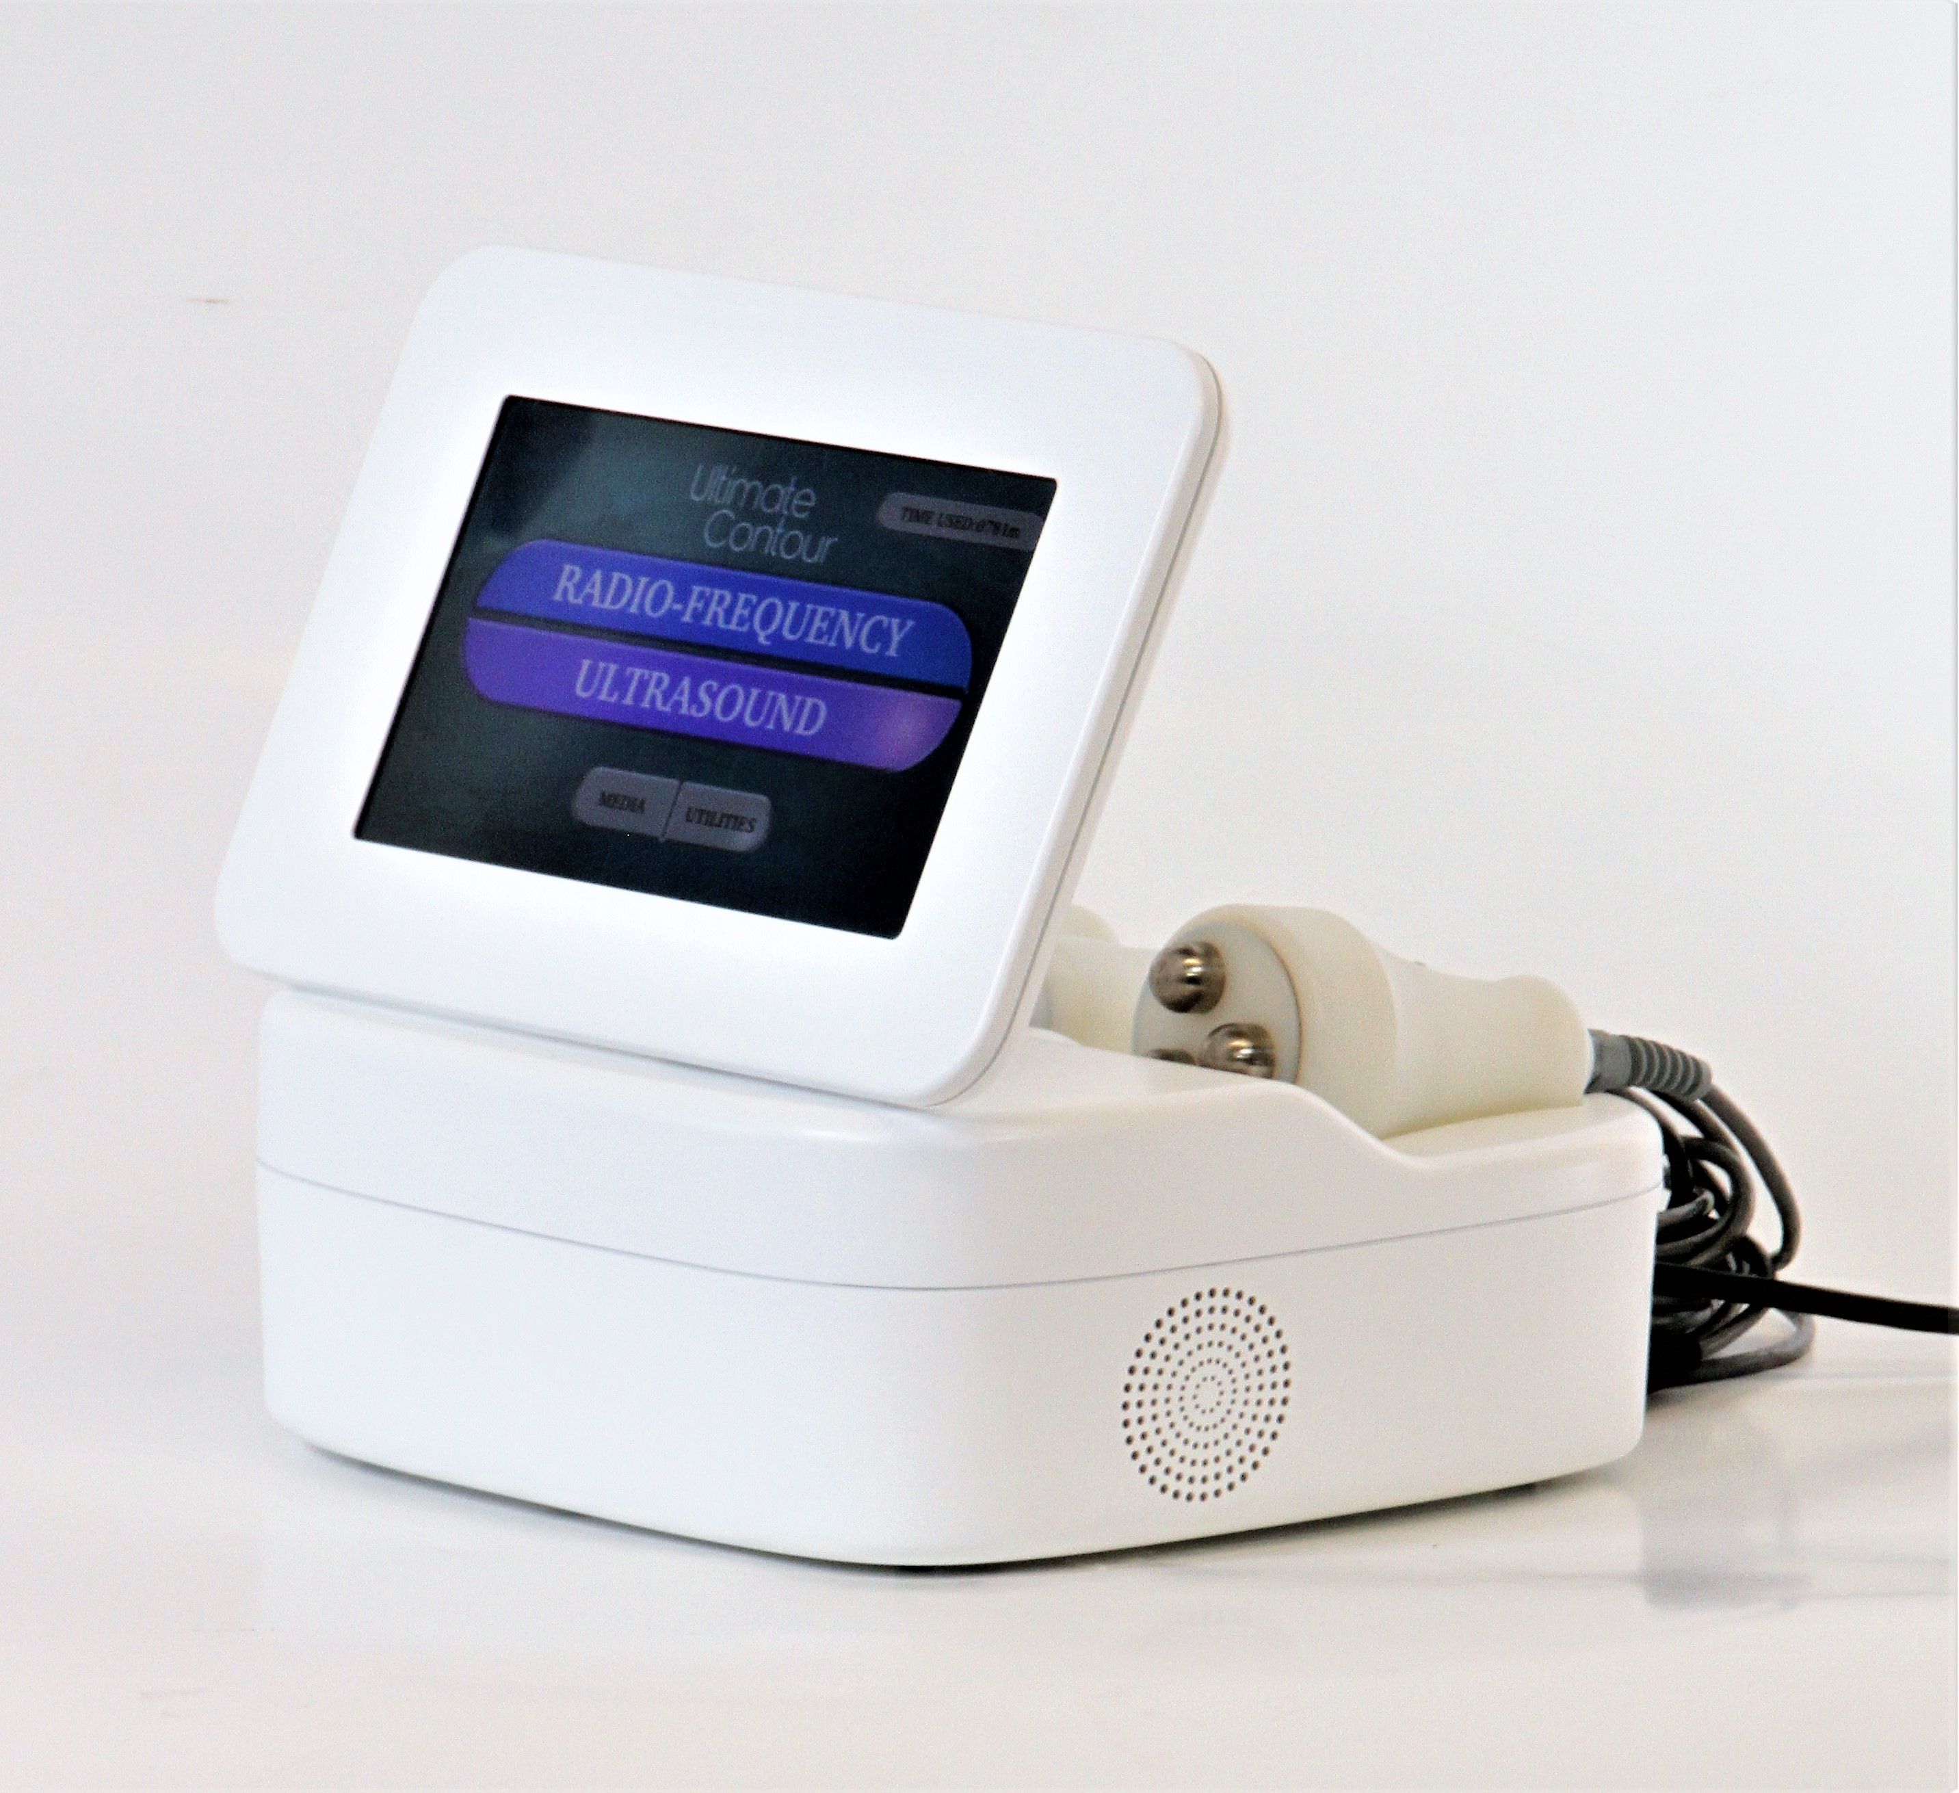
INTRODUCING

Slide 2
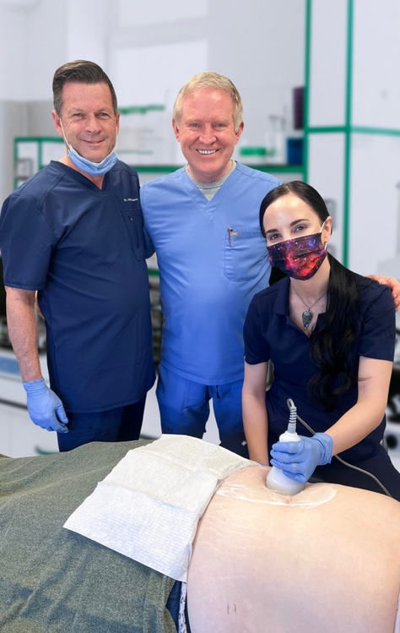
WHAT IS IT?
Non-invasive fat reduction
US: low frequency 40KHz
Comfortable - no heat
Ringing in ears
No consumables
Lower cost device

Slide 3
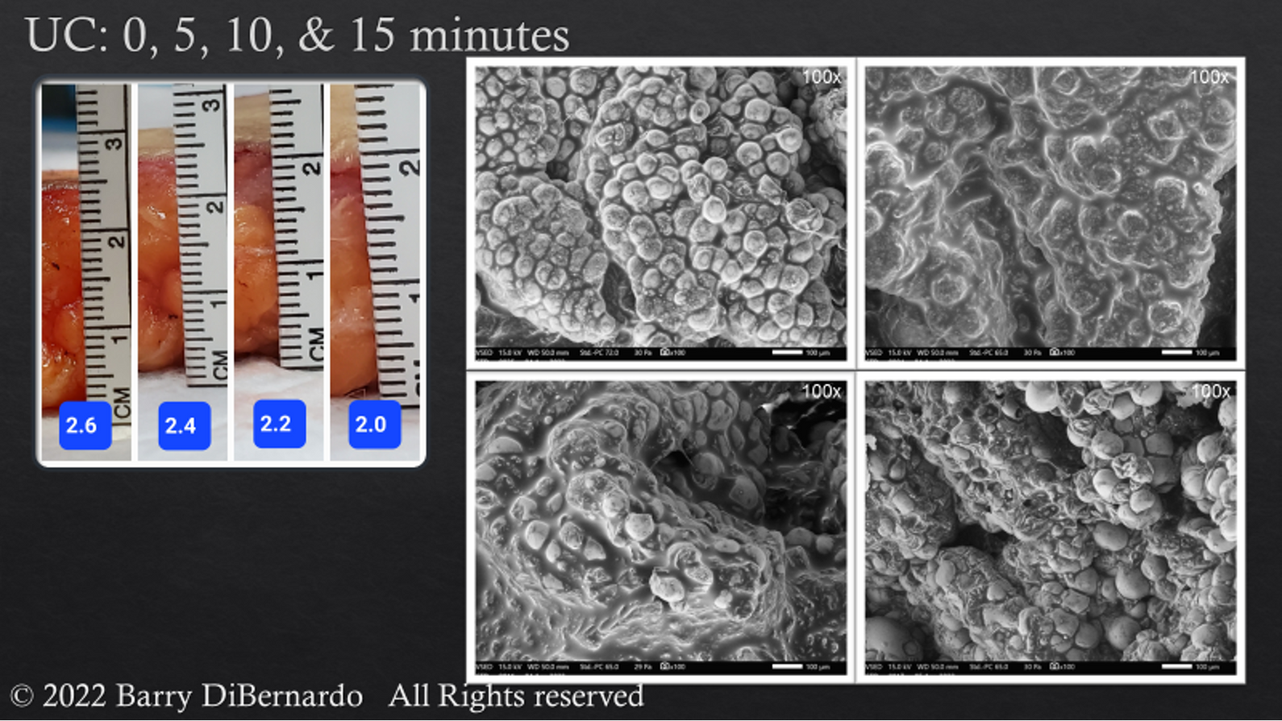

Slide 4
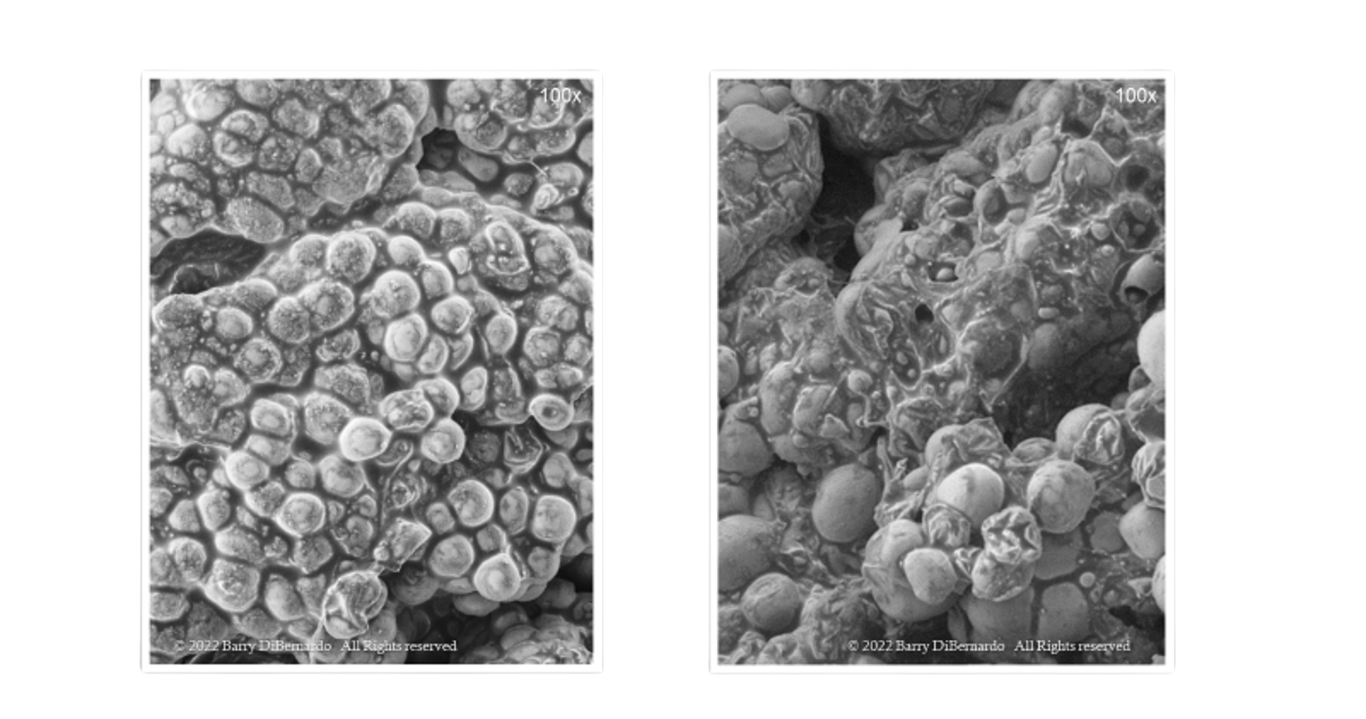
Before
After 15 Minutes of Ultrasound

Slide 5
That’s just 14 days!!
REAL RESULTS. FAST.
Patients typically lose one inch or more on the first visit.

Slide 6
That’s just 14 days!!
REAL RESULTS. FAST.
Patients typically lose one inch or more on the first visit.

Slide 7
That’s just 14 days!!
REAL RESULTS. FAST.
Patients typically lose one inch or more on the first visit.

Slide 8
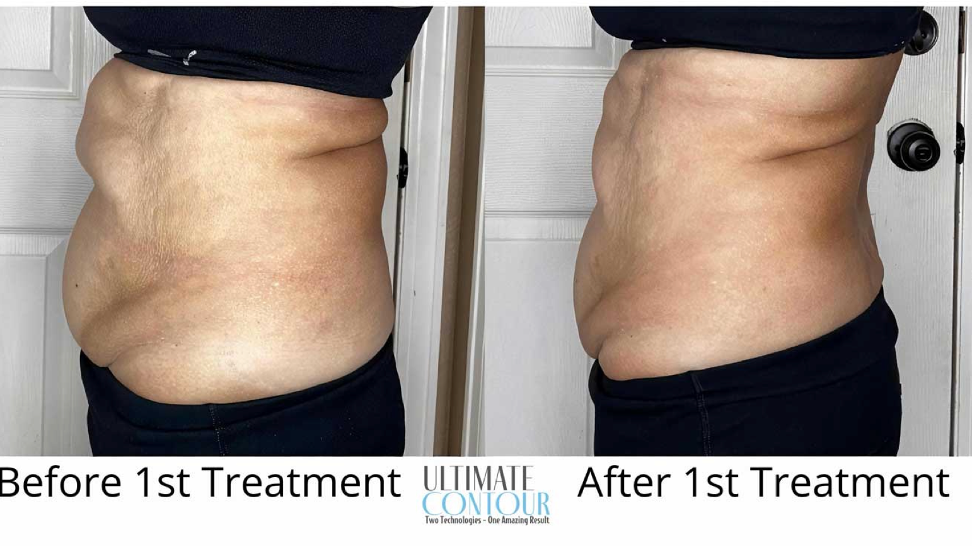

Slide 9
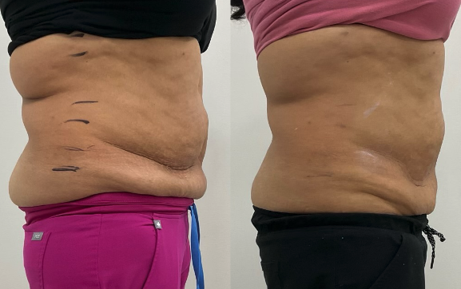
Two Treatments
Ultrasound, 2 days apart

Slide 10
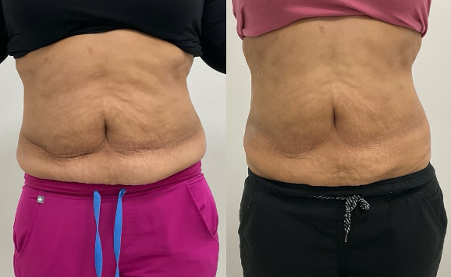
Two Treatments
Ultrasound, 2 days apart

Slide 11
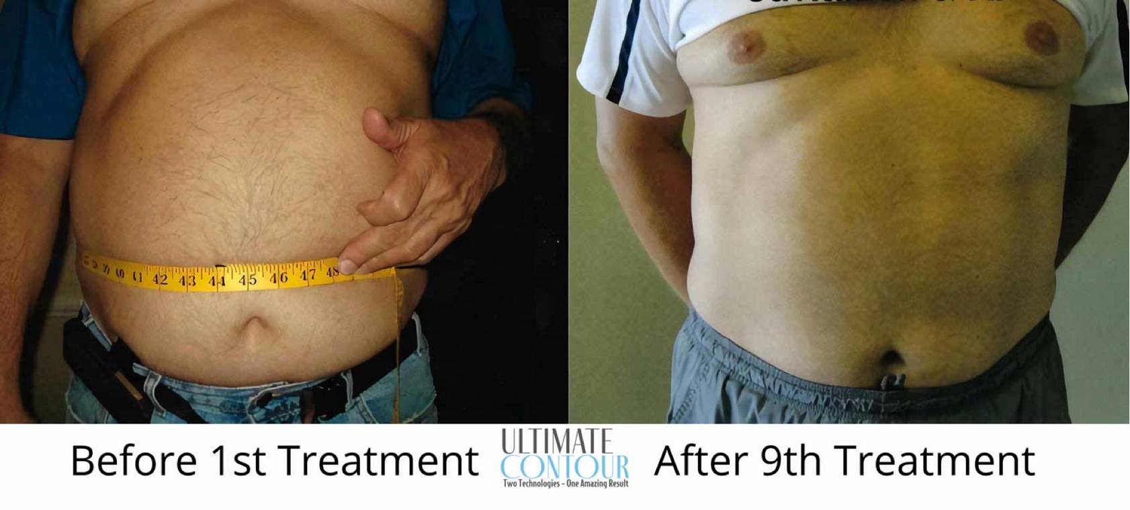

Slide 12
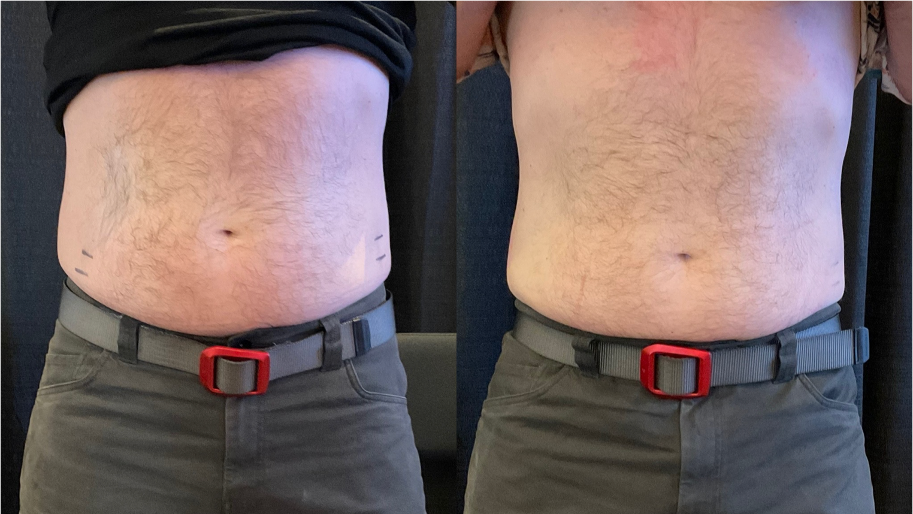
After 40 Minutes of Ultrasound

Slide 13
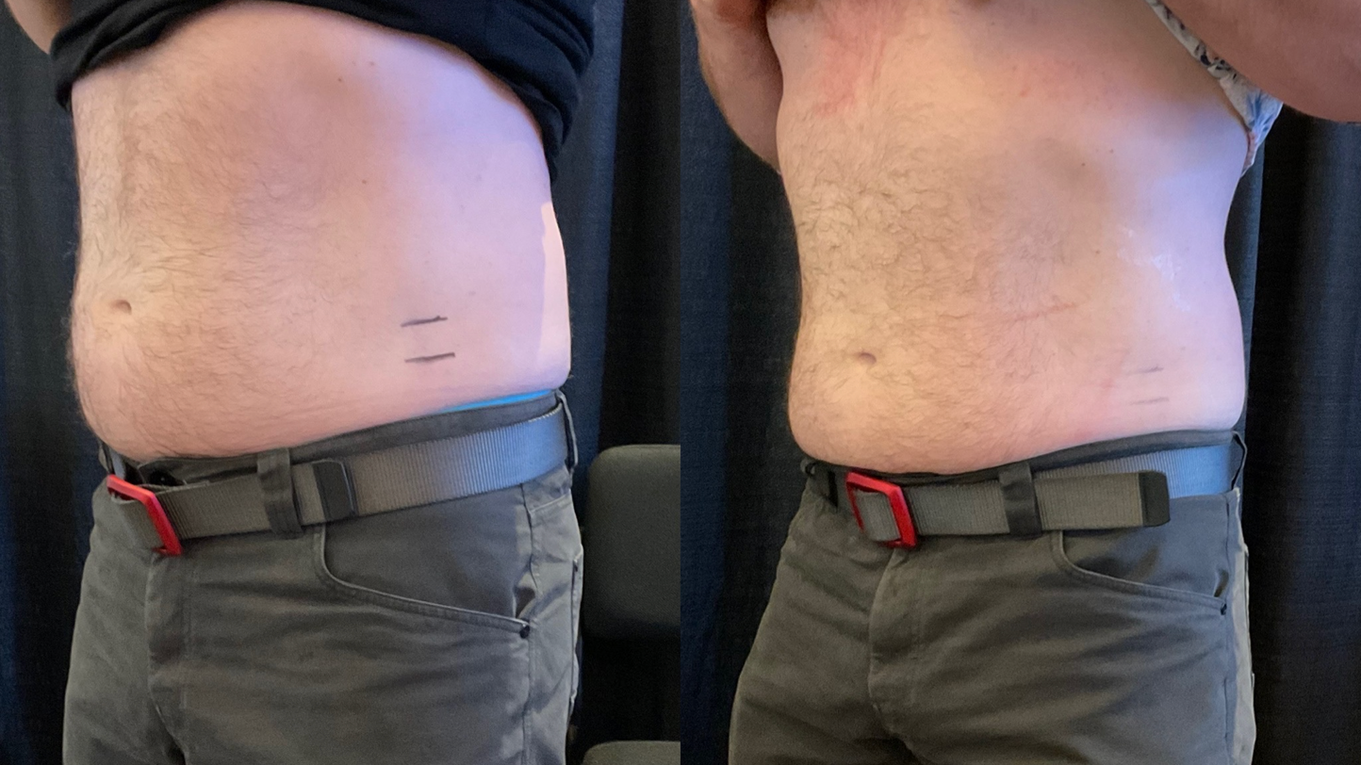
After 40 Minutes of Ultrasound

Slide 14
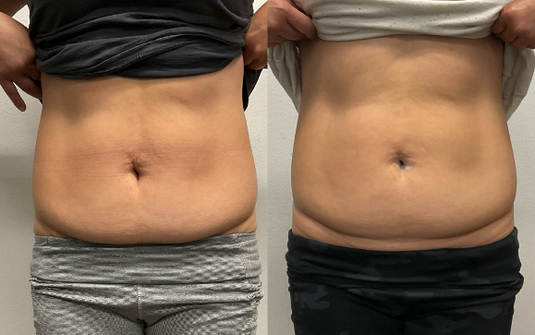
Two Treatments
Ultrasound, 2 days apart

Slide 15
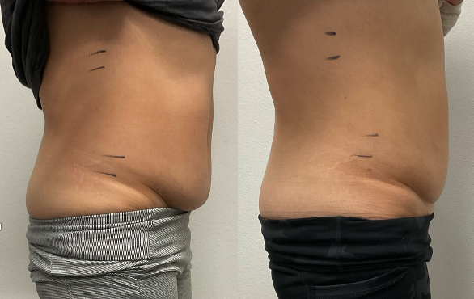
Two Treatments
Ultrasound, 2 days apart

Slide 16
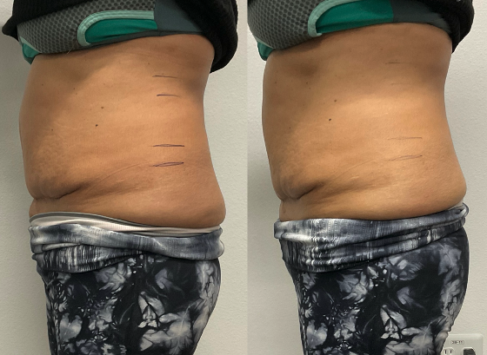
After 40 Minutes of Ultrasound

Slide 17
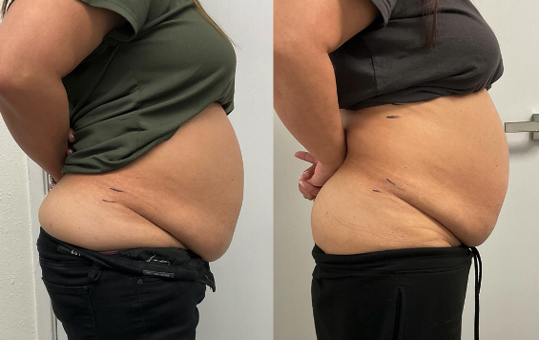
Two Treatments
Ultrasound, 2 days apart

Slide 18
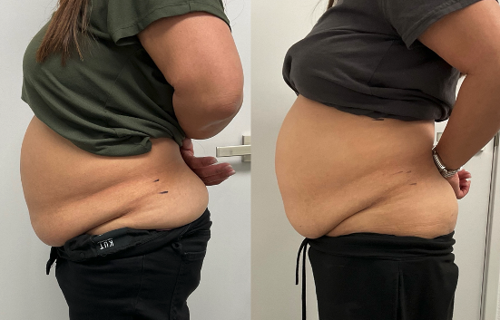
Two Treatments
Ultrasound, 2 days apart

Slide 19
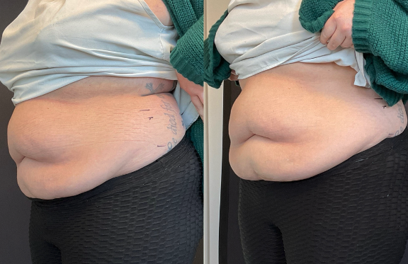
After 40 Minutes of Ultrasound

Slide 20
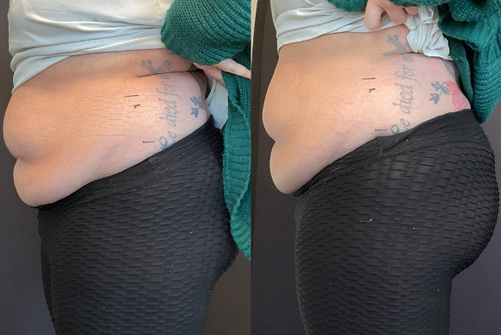
After 40 Minutes of Ultrasound

Slide 21
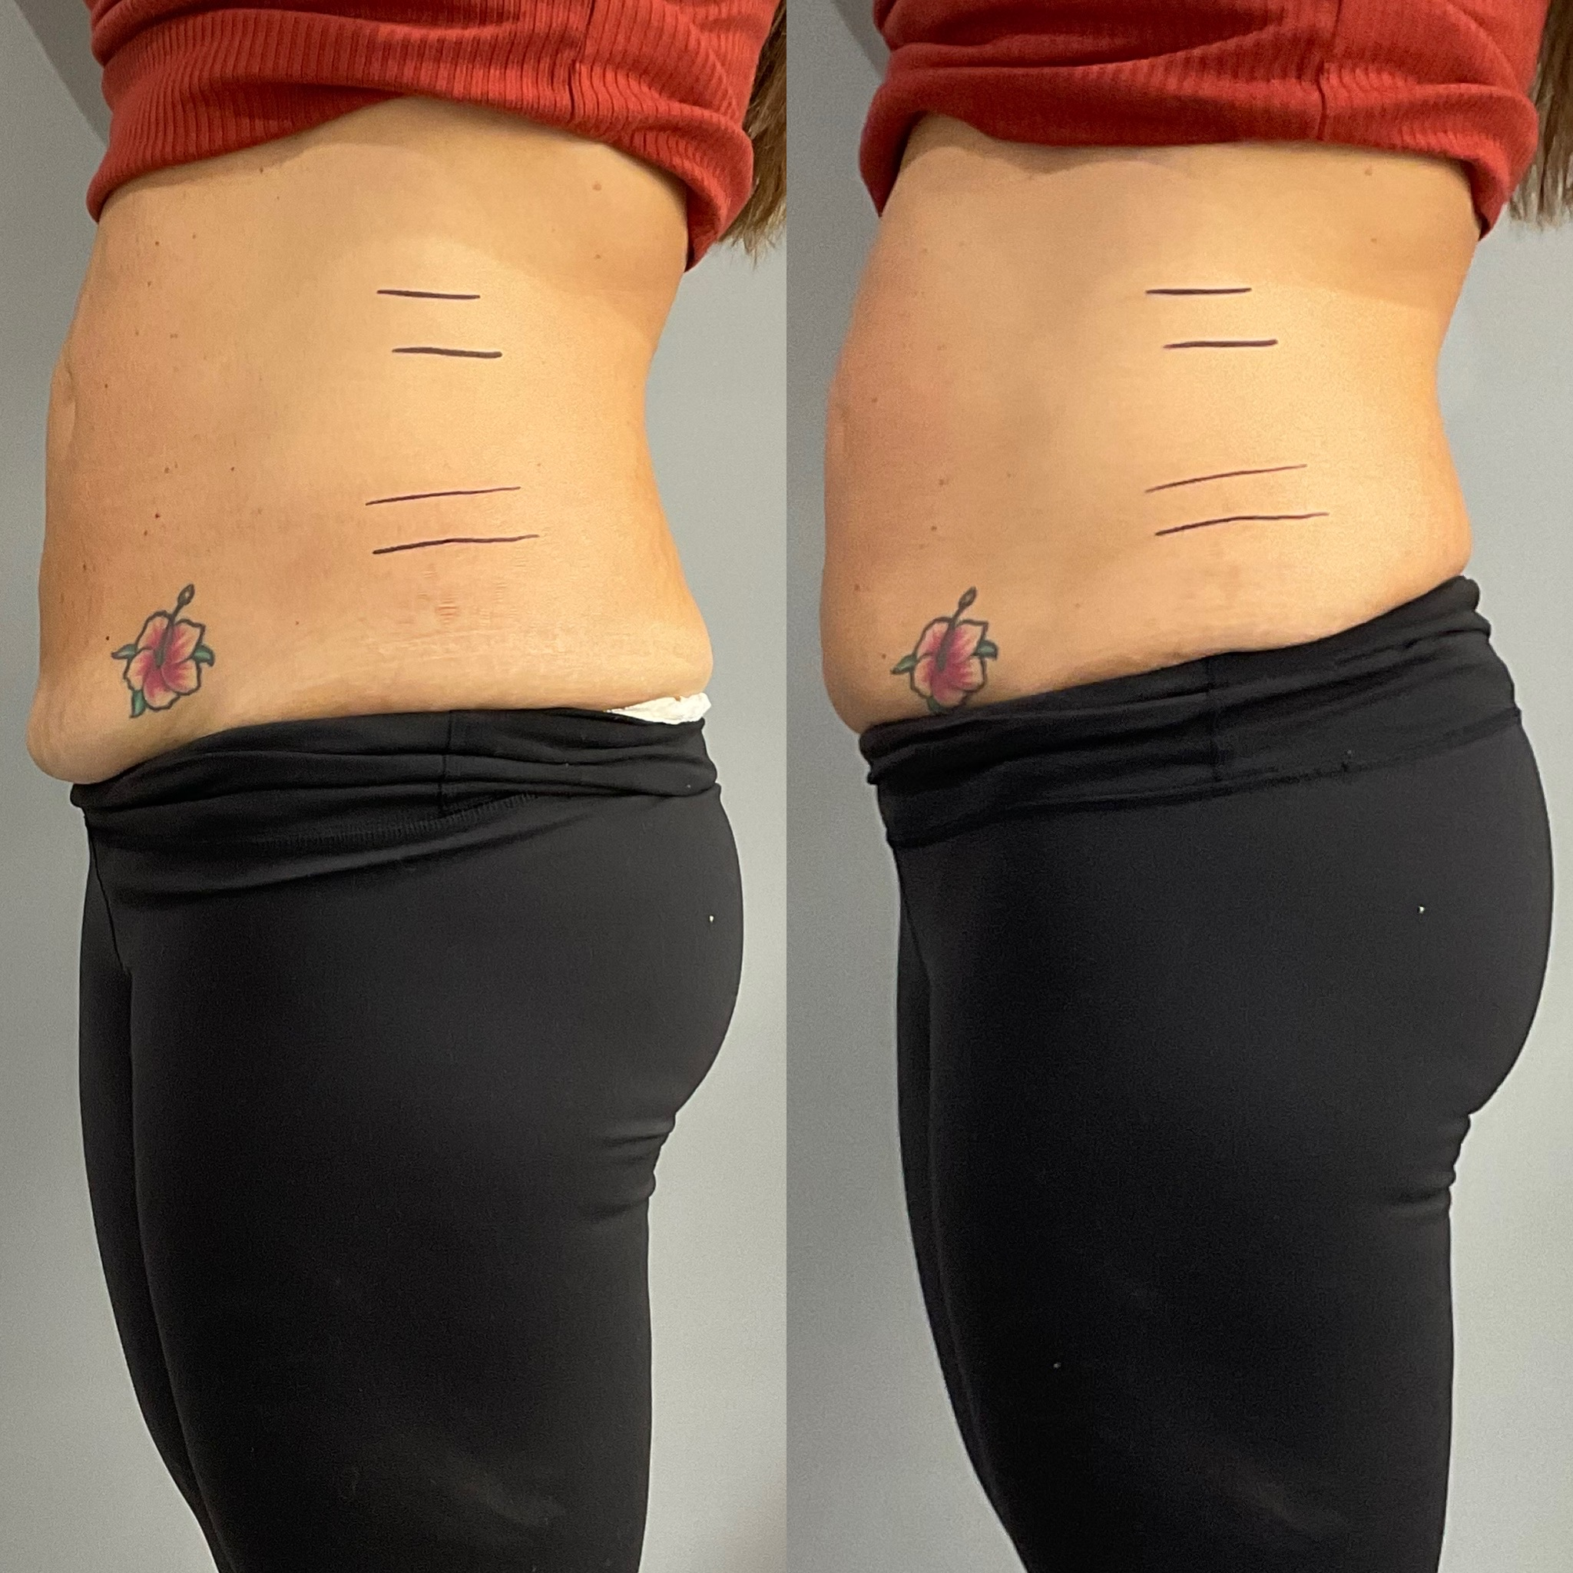
After 40 Minutes of Ultrasound

Slide 22
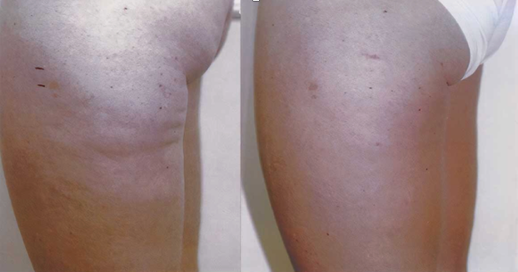
After 5 Treatments of Radio Frequency

Slide 23
After 4 Treatments of Radio Frequency

Slide 24
After 40 Minutes of Ultrasound

Slide 25
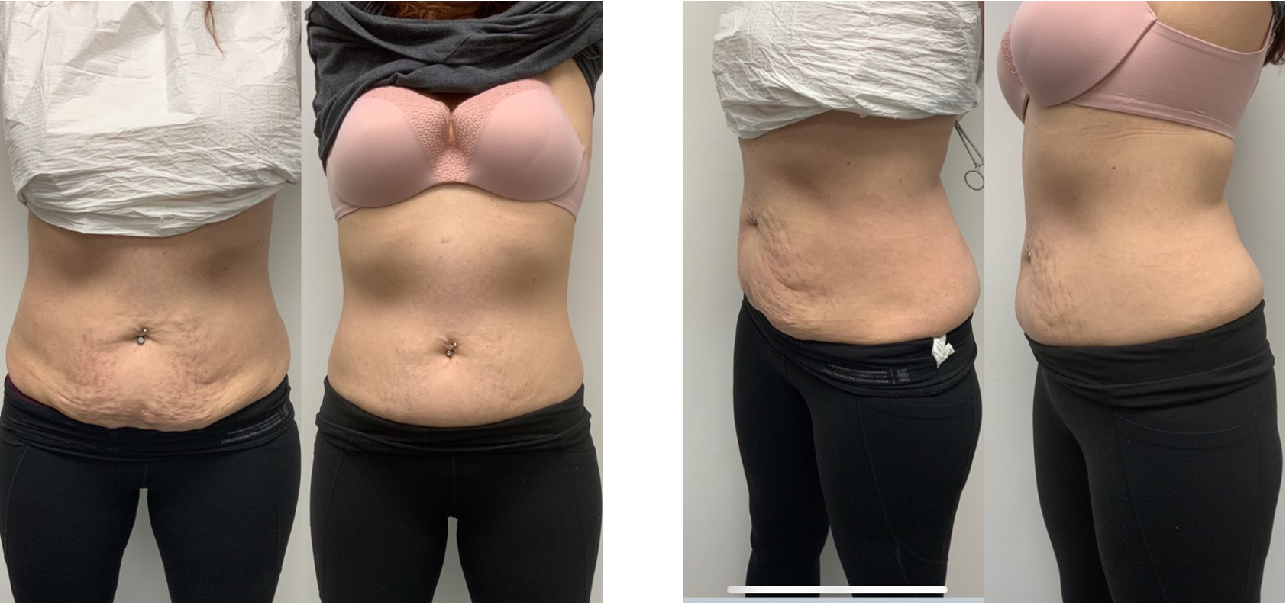
Before
After 3 treatments Ultrasound

Slide 26
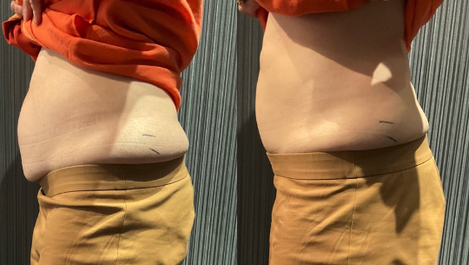
After 40 Minutes of Ultrasound

Slide 27
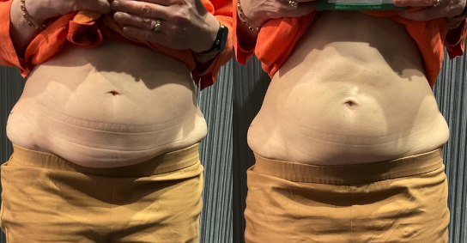
After 40 Minutes of Ultrasound

Slide 28
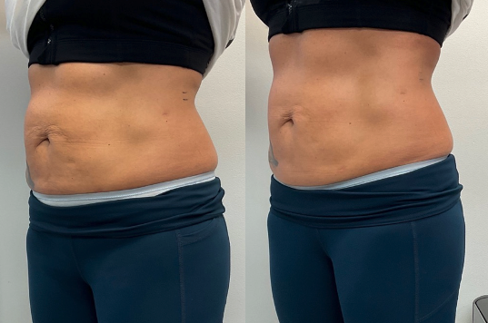
After 40 Minutes of Ultrasound

Slide 29
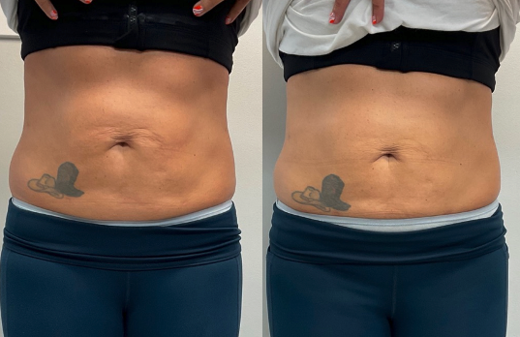
After 40 Minutes of Ultrasound

Slide 30
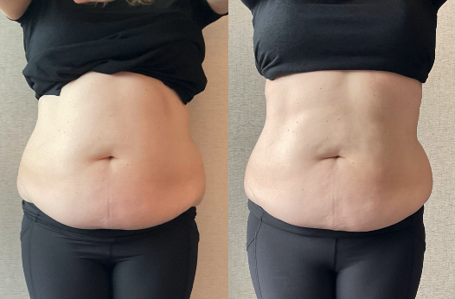
After 40 Minutes of Ultrasound

Slide 31
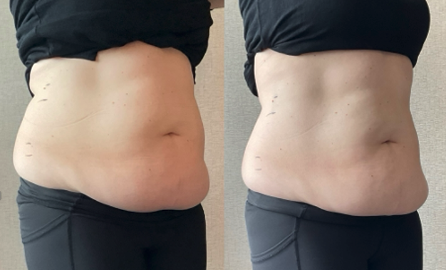
After 40 Minutes of Ultrasound

Slide 32
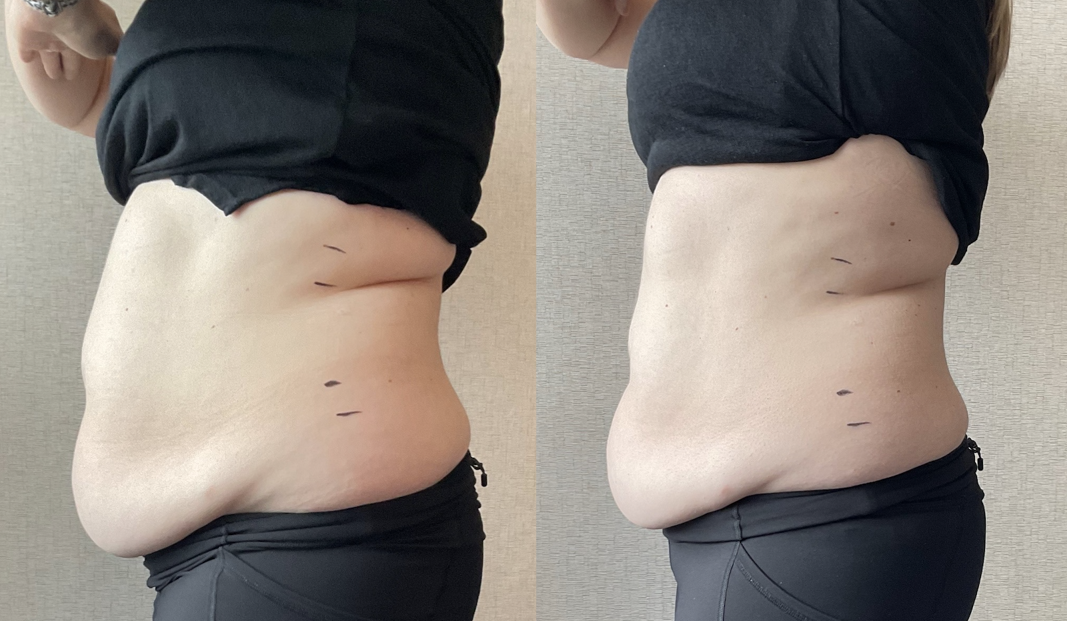
After 40 Minutes of Ultrasound

Slide 33
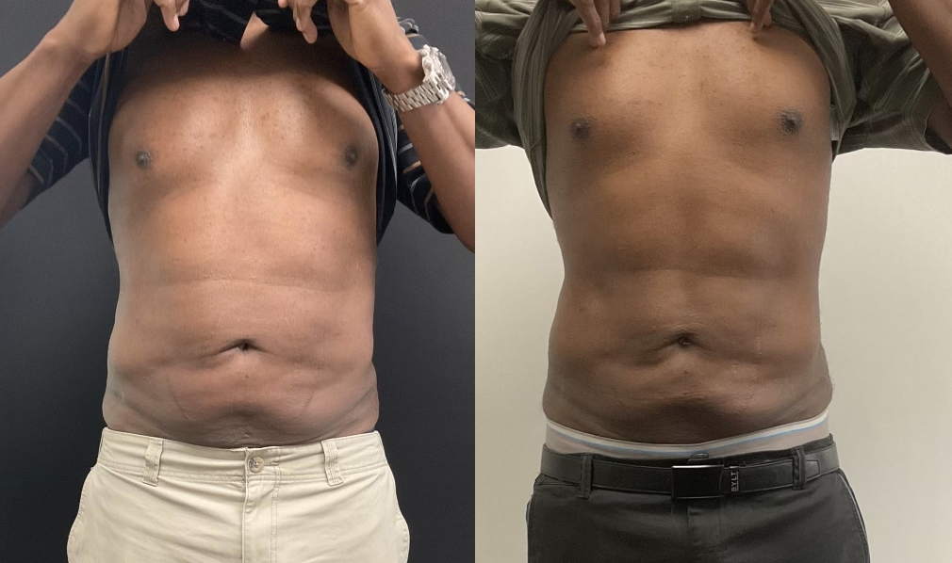
2 Treatments of Ultrasound

Slide 34
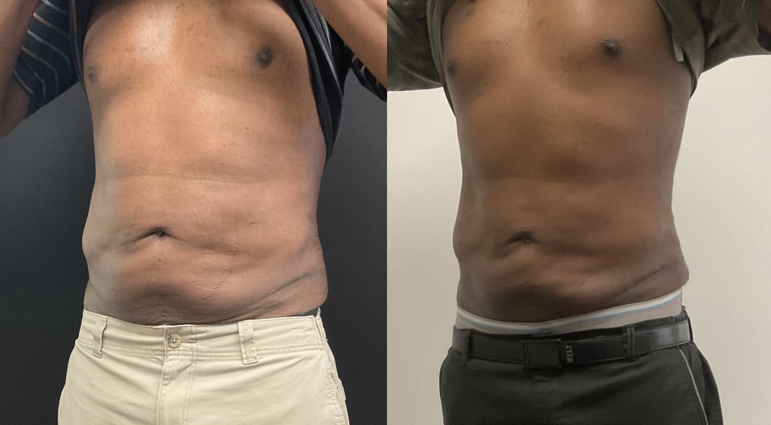
2 Treatments of Ultrasound

Slide 35
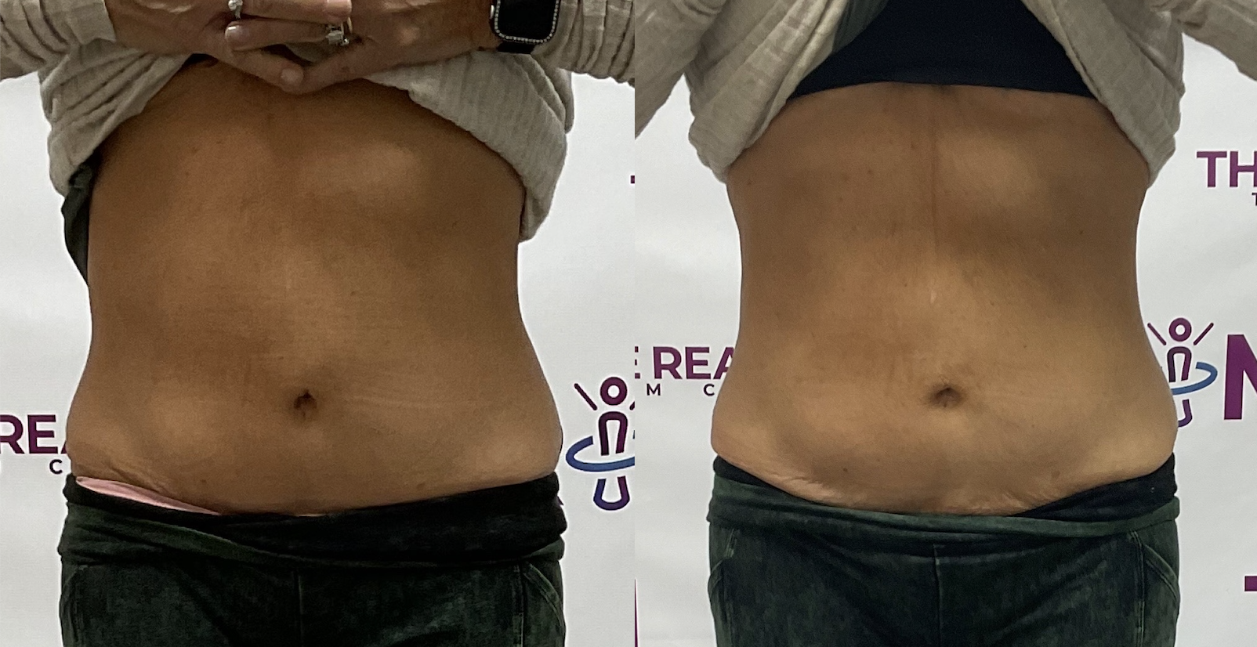
After 40 minutes of Ultrasound

Slide 36
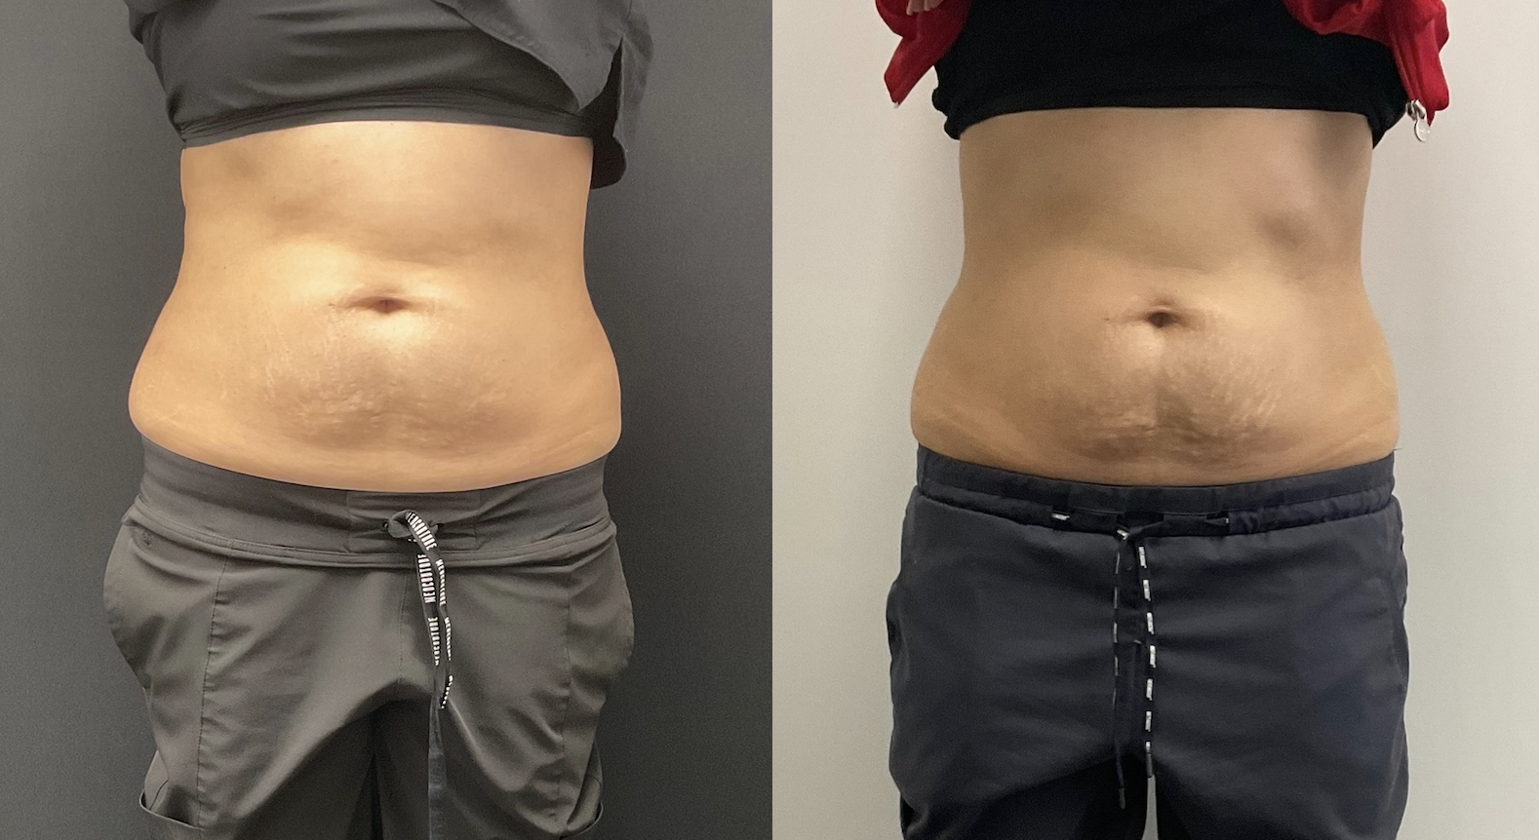
After 40 Minutes of Ultrasound

Slide 37
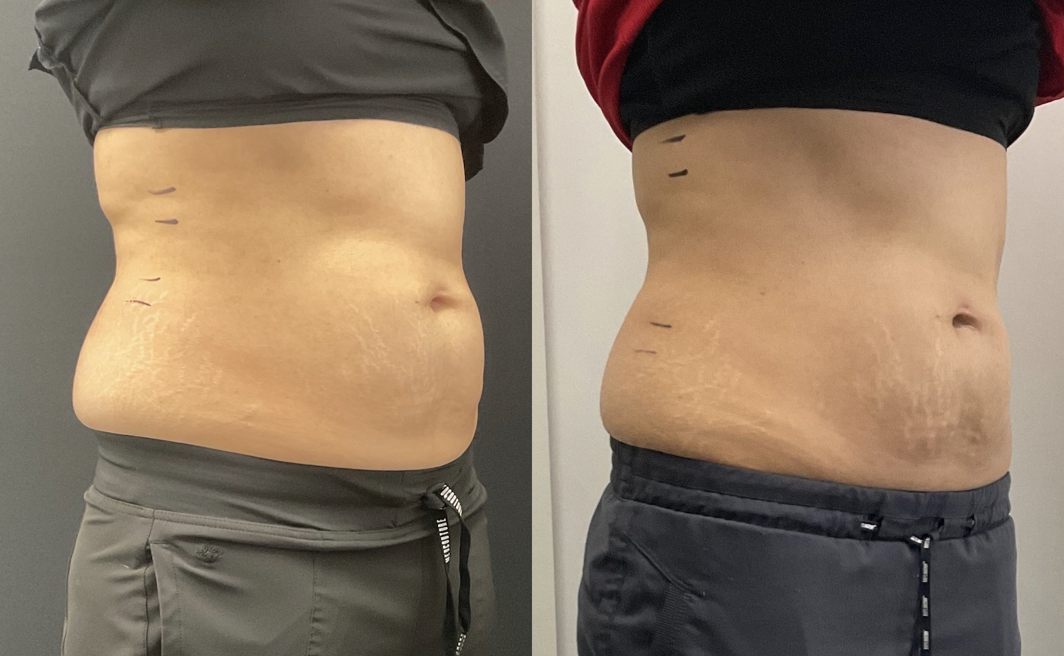
After 40 Minutes of Ultrasound

Slide 38
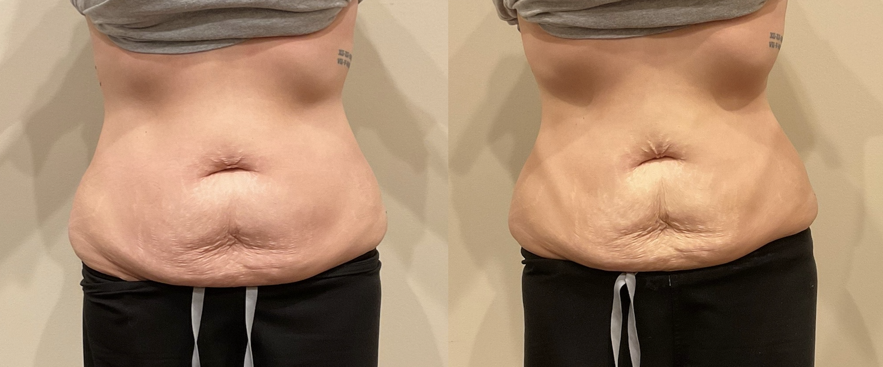
After 40 Minutes of Ultrasound

Slide 39
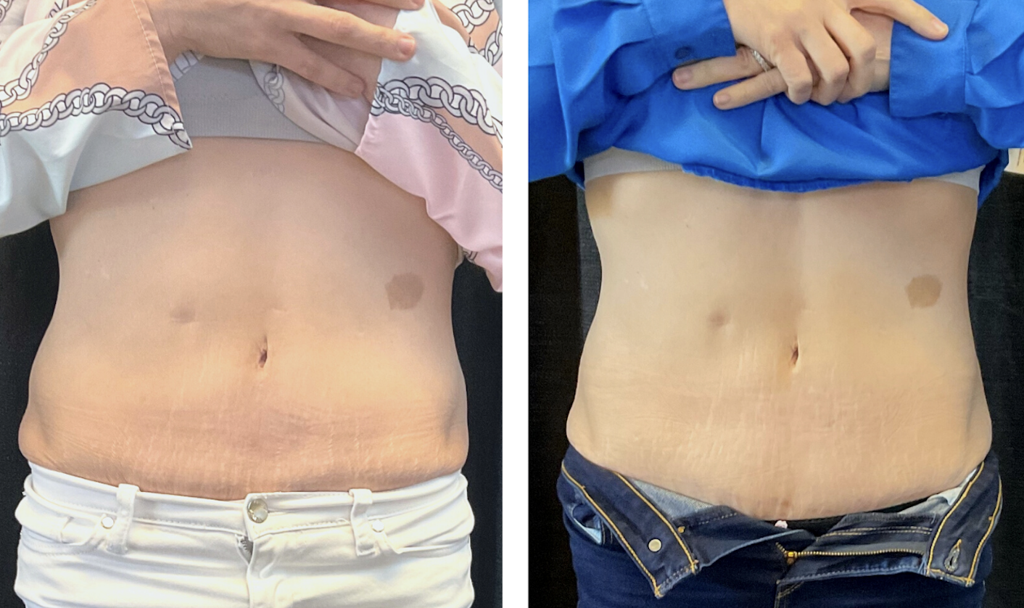
2 Treatments of Ultrasound

Slide 40
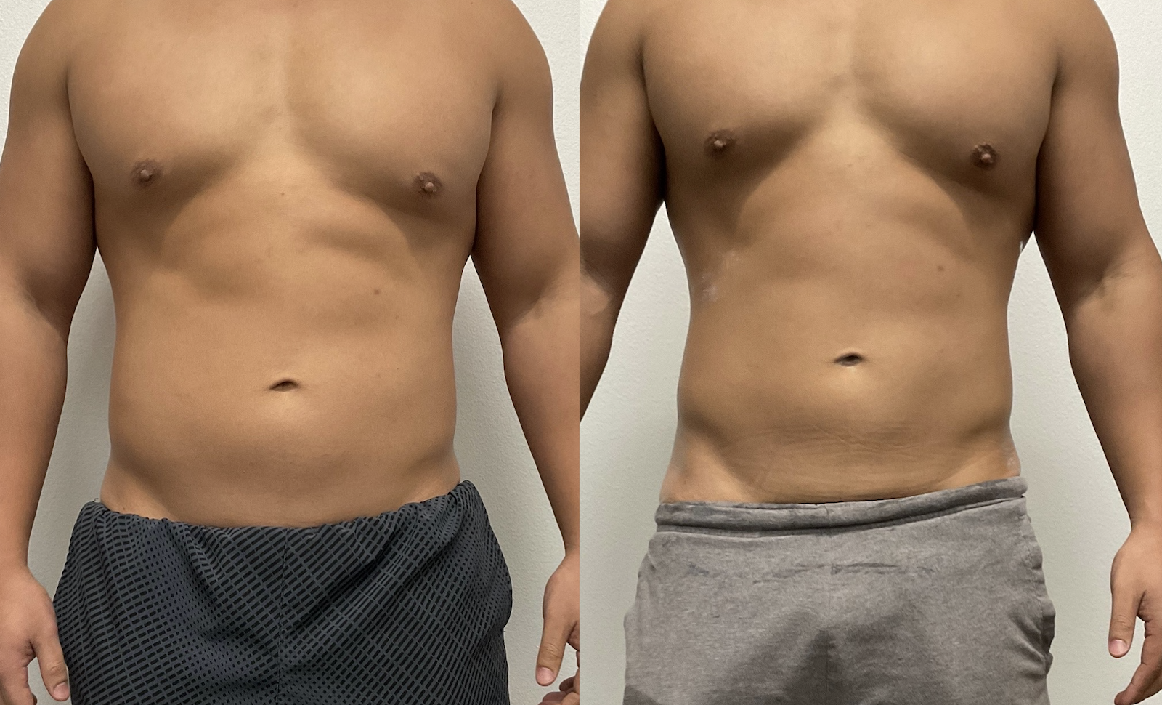
After 40 Minutes of Ultrasound

Slide 41
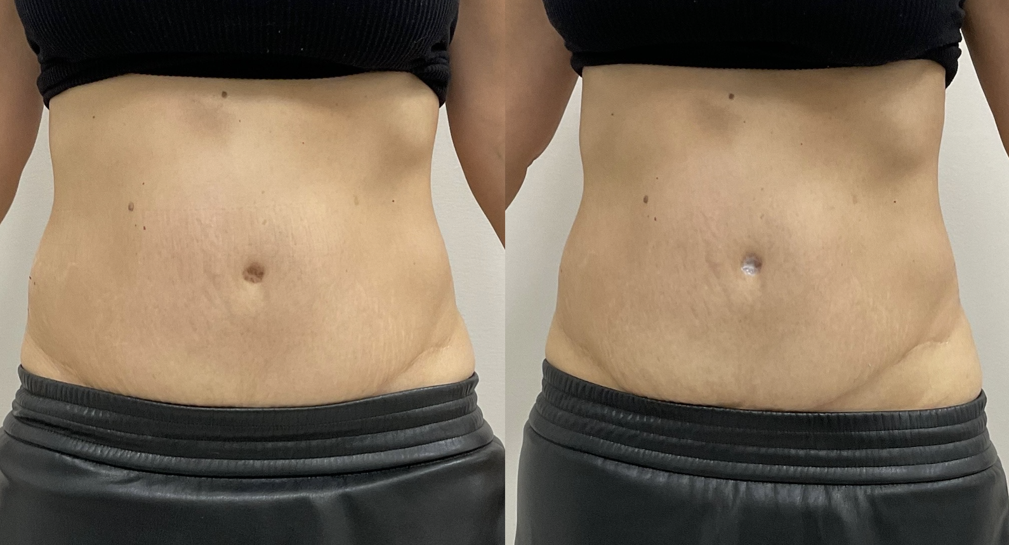
After 40 Minutes of Ultrasound

Slide 42
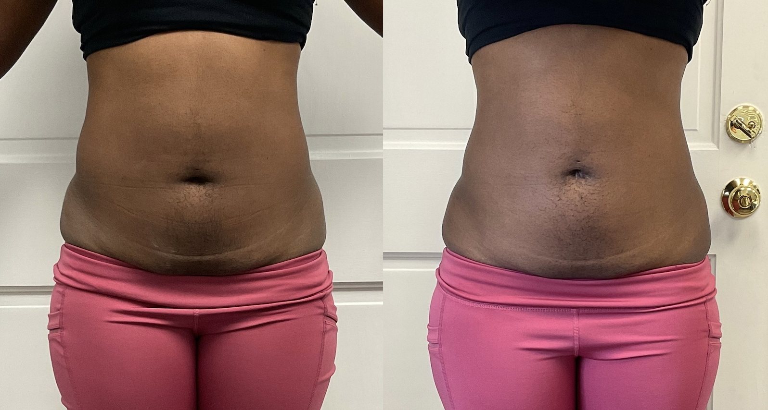
After 40 Minutes of Ultrasound

Slide 43
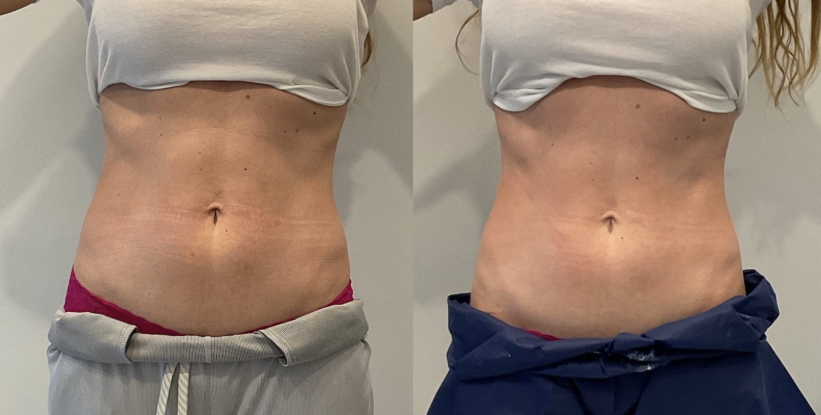
After 40 Minutes of Ultrasound

